Slide 1
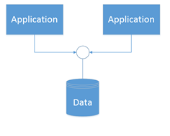
Data-Centric Architecture strengths and advantages
Suitable for complex problem e.g. speech and pattern recognition.
Very helpful for network based applications.
Useful in the systems that involve shared access to data with loosely coupled agents.
Consistency: It gathers all data in a single place and controlled primarily by the database itself in the form of stored procedures.
Code reuse: It uses the database as an integration point. It introduces common functionality in the database itself using DB functions and stored procedures.

Slide 2
Data-Centric Architecture concerns and issues
Not suitable for every problem
Designing of good controller is very important
If number of knowledge sources requested to access the shared data increases then bottleneck problem arises at the controller.
Evolution: It is hard to perform refactoring, or modifying software according to new requirements.
Complexity growth: Application code tends to grasp easily in the initial stages of the project. However, the more complex a project gets, the less appealing the data-centric approach becomes.

